Slide 1
EC3290 – Software Requirements Engineering
Topic 4 – Software Verification and Validation

Slide 2
Learning Objectives
Understand the difference between verification and validation
Explore techniques used in requirement V&V
Learn how to identify conflicts, inconsistencies, and incompleteness in requirements

Slide 3
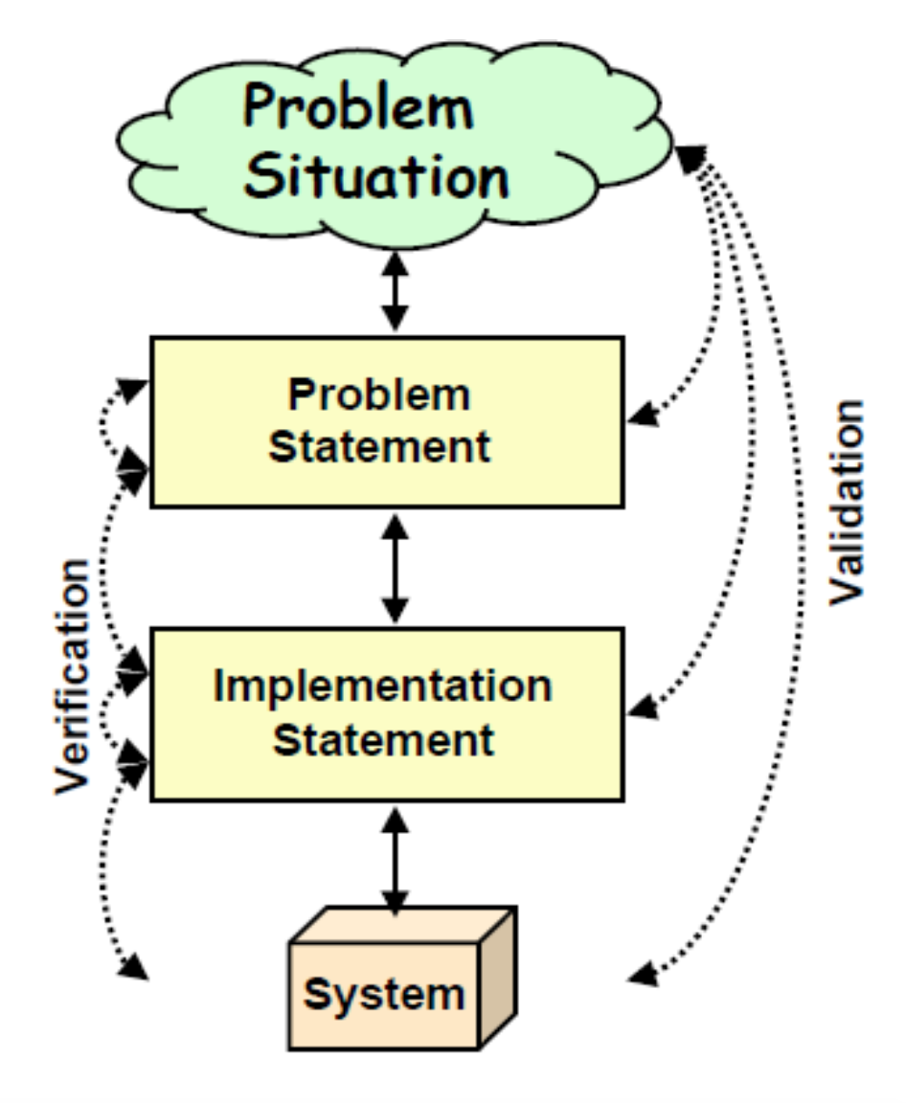
What is Requirements V&V?
Verification
Check if the requirement document is correct and logically structured.
Are we building the product right?
Validation
Confirm if the documented requirements truly reflect the needs of stakeholders.
Are we building the right product?

Slide 4
Importance of V&V
Reduces costly rework in later stages
Ensures customer satisfaction
Improves software quality
Example: NASA lost a $125 million spacecraft because of a requirements error. That's one expensive typo.

Slide 5
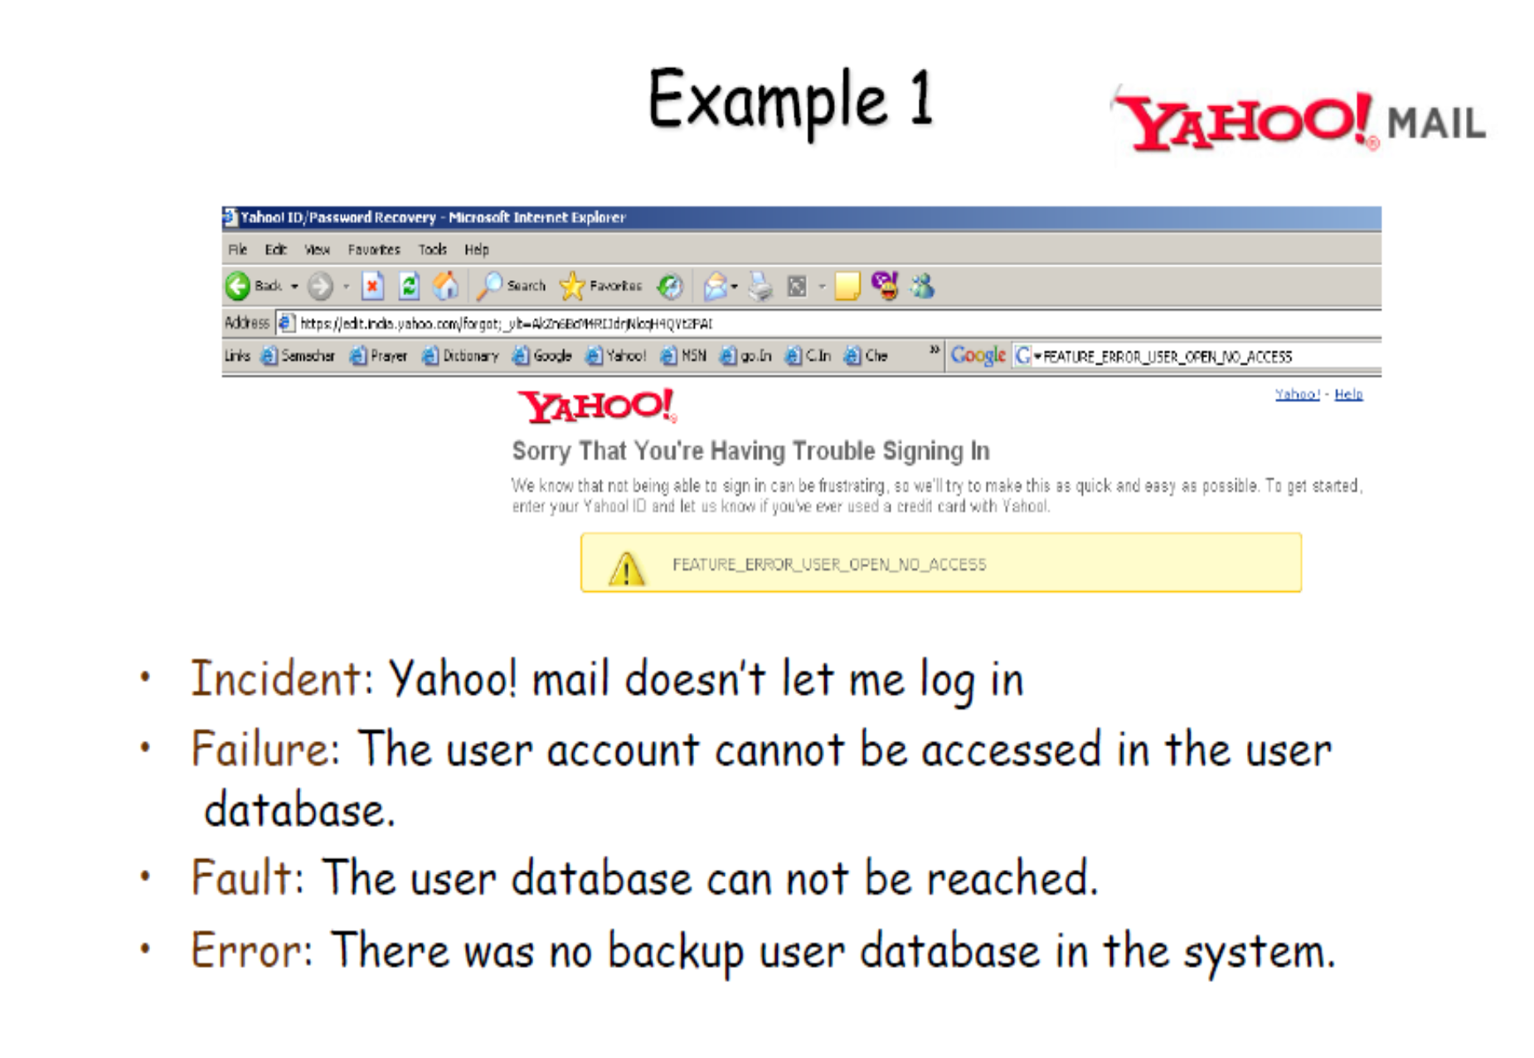

Slide 6
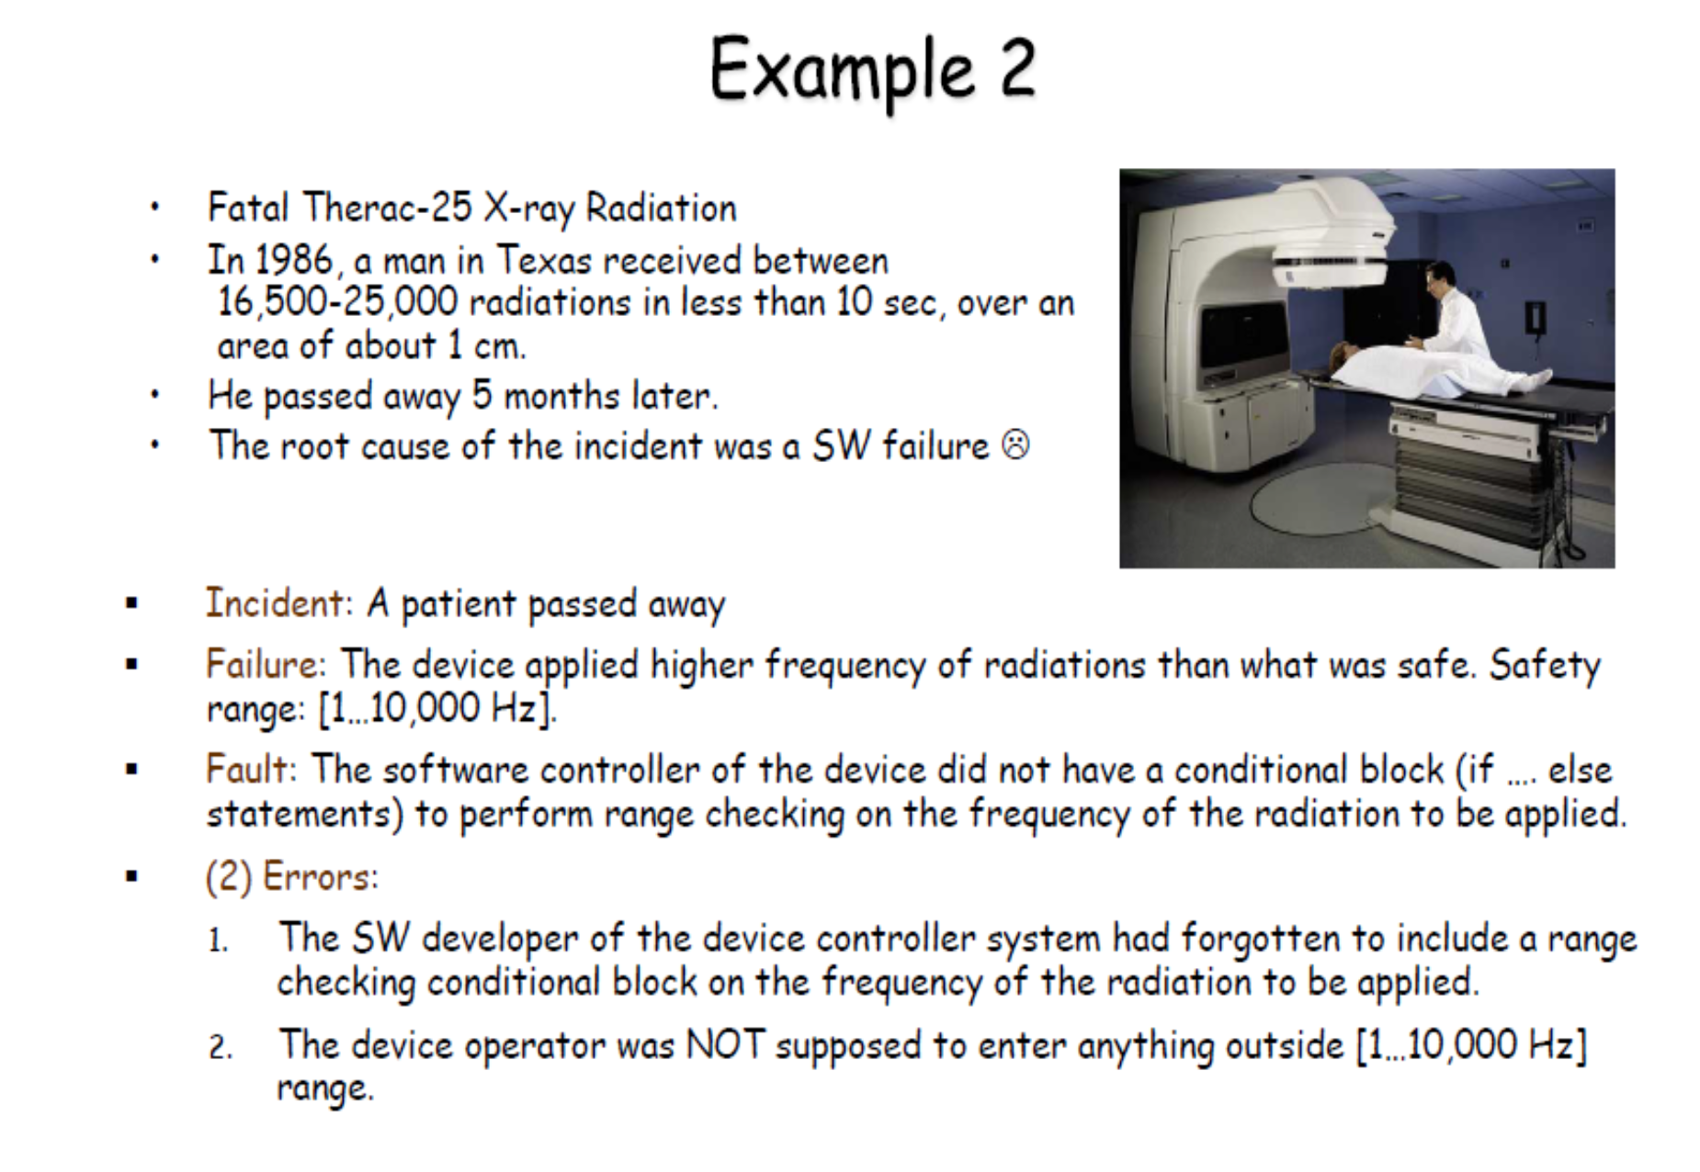

Slide 7
When Does V&V Happen?
Throughout the software development life cycle (SDLC)
Especially during and after requirements elicitation and specification
Before design and implementation begin

Slide 8
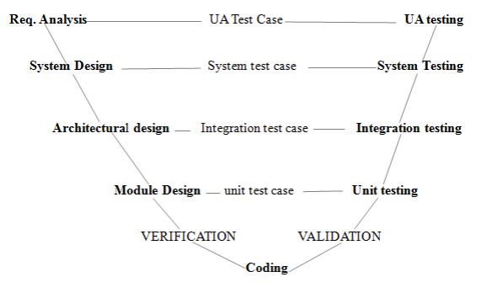

Slide 9
Verification: In-Depth
Ensures the software meets the specified requirements
Focuses on correctness and consistency
Techniques: Reviews, Walkthroughs, Inspections

Slide 10
Validation: In-Depth
Ensures the software fulfills user needs and expectations
Involves stakeholders
Techniques: Prototyping, User Feedback, Acceptance Testing

Slide 11
The V&V Relationship
Verification = Internal check
Validation = External check
Both are essential; one without the other can lead to disaster

Slide 12
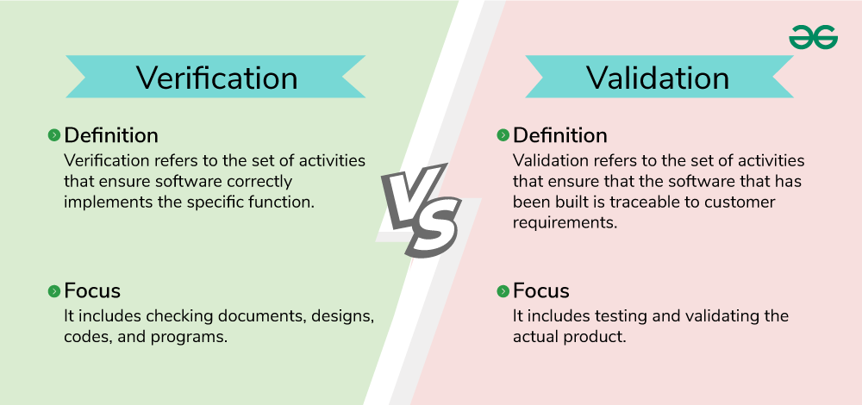

Slide 13
V&V Activities in Requirements Phase
Requirements review
Consistency checks
Prototyping for validation
Traceability analysis

Slide 14
Inspection Techniques
Formal, peer-based examination of documents
Checklist-driven
Focus on:
Ambiguities
Conflicts
Incompleteness

Slide 15
Walkthroughs
Informal group discussion
Presenter leads; others provide feedback
Goal: Understand and evaluate the requirements

Slide 16
Reviews
Technical review meetings
Used to detect errors early
May be formal or informal
Example: Weekly review sessions with client or internal QA team.

Slide 17
Prototyping for Validation
Build a mock-up of the system or interface
Gather feedback from users
Helps discover hidden needs
Because "I’ll know it when I see it" is not a requirement.

Slide 18
Acceptance Criteria and Testing
Define what it means for a requirement to be "done"
Involve end-users in writing test cases
Must be measurable and testable

Slide 19
Conflict Detection in Requirements
Conflict: Two or more requirements contradict each other
Example: One requirement says “System must run in 2 seconds,” another says “Must perform deep analysis.”
Solution: Use traceability and conflict matrices.

Slide 20
Inconsistency Detection
Different parts of the requirement contradict or don’t align
Example: “All users must log in” vs. “Guest users can access without login”
Technique: Cross-checking related requirements.

Slide 21
Completeness Check
Ensures all required functionalities are described
No missing constraints or conditions
Checklist: Are all stakeholders’ needs addressed? Are all interfaces defined?

Slide 22
Ambiguity Detection
Ambiguous: “The system should be fast”
Clear: “System response time shall not exceed 2 seconds under load”

Slide 23
Traceability Matrix
Maps requirements to:
Stakeholder needs
Design components
Test cases Benefit: Helps detect missing or extra functionality Example table: Req1 → Use Case 1 → Module A → Test Case 5

Slide 24
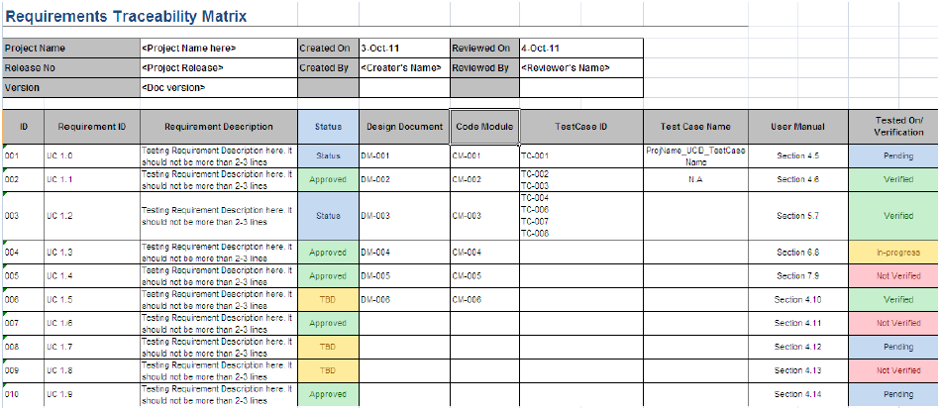

Slide 25
Tool Support for V&V
Tools like:
IBM DOORS
ReqView
JIRA (for issue tracking)
Help automate conflict detection and versioning

Slide 26
V&V in Agile Context
Continuous validation via sprints and reviews
Definition of Done (DoD) ensures verification
User stories and acceptance criteria help validate

Slide 27
Common Mistakes in V&V
Skipping reviews
Relying too much on tools
Not involving users in validation

Slide 28
Summary
V&V ensure correct and complete requirements
Verification = “Did we build it right?”
Validation = “Did we build the right thing?”
Use a variety of techniques: inspection, prototyping, testing

